Slide 1


Sampling Strategies for High-Resolution Image Processing
CSA0504 – Computer Vision
Presented By:
Guided by:
Dr. P. Mathivanan
N. Akhil Kumar
(192425128)

Slide 2


Introduction
Optimal Sampling Strategies for High-Detail Applications
Sampling is the process of converting continuous signals into digital data.
High-detail applications require accurate sampling to preserve fine details and minimize information loss.
Common applications include medical imaging, satellite imaging, digital photography, and 3D scanning.
Choosing the right sampling strategy improves image quality, accuracy, and system performance

Slide 3
Types of Sampling Strategies
Common Sampling Methods
Uniform Sampling: Samples are taken at equal intervals and are widely used in digital systems.
Adaptive Sampling: Sampling rate changes depending on the complexity of the image or signal.
Random Sampling: Samples are selected randomly to reduce repetitive patterns and aliasing.
Oversampling: Uses a higher sampling rate than required to improve image quality and reduce noise.

Slide 4


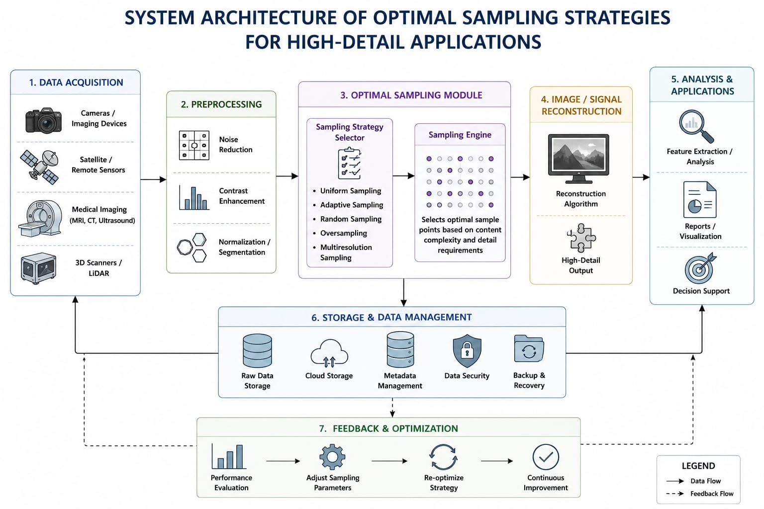
System Architecture

Slide 5
Case Study
Case Study: MRI Medical Imaging
MRI scans require high-resolution images for accurate diagnosis.
Adaptive and oversampling techniques capture fine details of tissues and organs.
These methods reduce image noise and improve clarity.
Better sampling helps doctors detect diseases at an early stage and make accurate treatment decisions.

Slide 6
Advantages & Challenges
Advantages
Produces high-quality and detailed images.
Improves accuracy in diagnosis and analysis.
Reduces noise and image distortion.
Enhances overall system performance.
Challenges
Requires more storage space.
Increases processing time.
Higher computational cost.
Needs advanced hardware for efficient processing.

Slide 7
Conclusion
Conclusion
Optimal sampling strategies are essential for high-detail imaging applications.
Techniques such as adaptive sampling and oversampling improve image accuracy.
Proper sampling reduces errors and preserves important details.
These strategies are widely used in healthcare, remote sensing, industrial inspection, and scientific research.
Selecting the appropriate sampling method ensures reliable and high-quality digital imaging.

Slide 8
THANK YOU !

